Slide 1
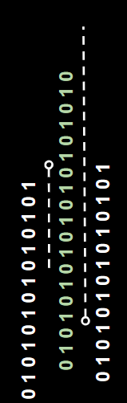
SQL Injection Workshop

Slide 2
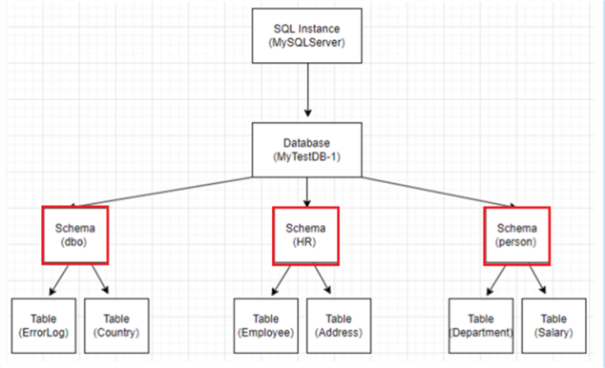
What is SQL (Structured Query Language)?
SQL is a computer programming language that can be used to interact with a relational database. These tools include:
Selecting
Updating
Deleting
Inserting
MySQL, SQLite, PostgreSQL
Notes:
Relational database → look at the tree, in a db server, tables are connected in a tree format, and can be interconnected
The syntaxic difference between most SQL languages are not super different… easy to pick up

Slide 3
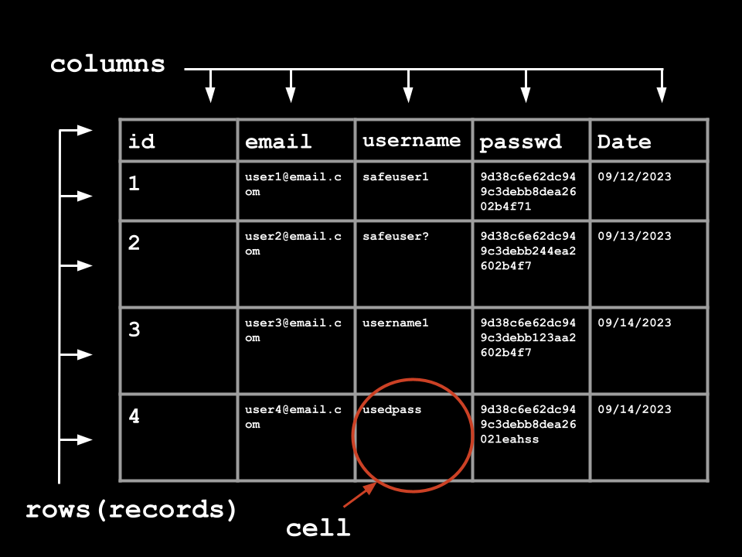
Database Table Structure and Terms
Columns
Rows
Cells
Primary Key
Foreign Key
Notes:
Primary Key → a unique identifier in a table. (like a id, everyone gets their own)
Foreign Key → a column that connects two relational databases together, so like in this example, the id may link to another table that is related to the information but in a different context / setting.

Slide 4
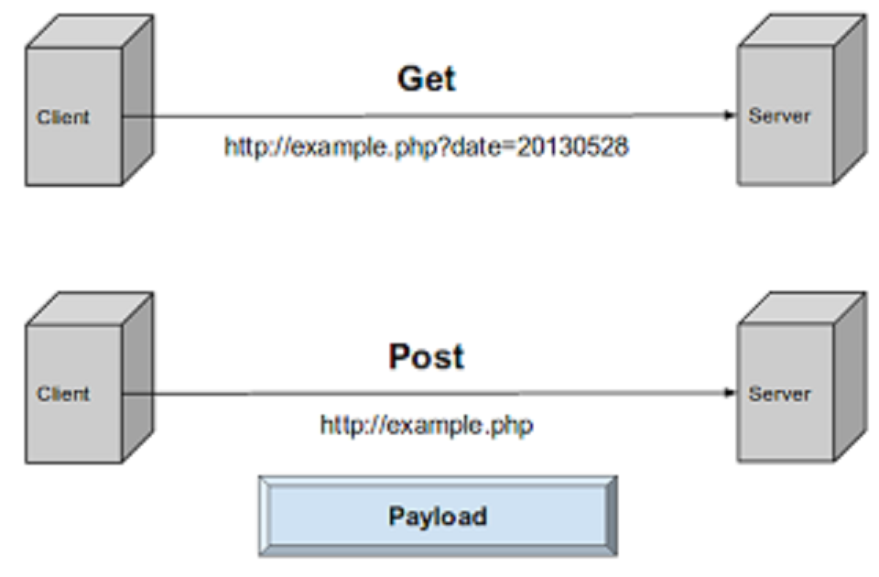
How does the Website Send Information to Database?
HTTP REQUESTS:
(Hypertext Transfer Protocol - client-server communication, server receives different requests then sends a response)
GET → request data from the server, can be cached and remain in user history
POST → send data to a server to create/update a resource, not cached nor added to user history
Notes:
Hypertext Transfer Protocol is one of the various transport level protocols
There is a lot more then just HTTP GET and POST request like… COOKIE, SESSION, PUT, HEAD, DELETE
Rule of thumb: post requests are safer dealing with confidential information; get request require less from server side so for less confidential things they are a good option (reloading a page does not require an additional request)

Slide 5
MySQL Syntax
4 Basic Commands: SELECT, INSERT, UPDATE, DELETE
Other useful commands → UNION
#
FROM
Ever confused or lost? Look at MySQL Documentation
MySQL :: MySQL 8.0 Reference Manual
Notes:
SELECT: select a column in a table, can be used in conjunction with FROM or UNION
FROM: select from a specific table
UNION: append multiple select statements into one
#: MySQL comment, use it comment out parts of query that you do not want

Slide 6
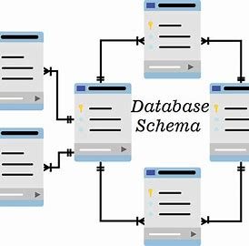
What is Information Schema?
Information Schema contains the metadata information of a table (read-only), and how databases relate to each other.
It can be called different ways:
information_schema.columns
information_schema.tables
information_schema.views

Slide 7
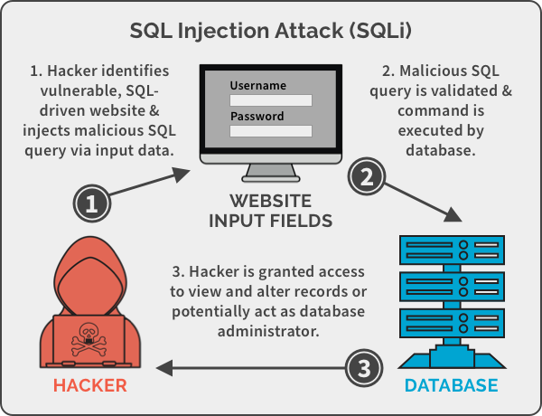
What is SQLi?
Notes:
Identify
Execute
Access

Slide 8
Different types of SQLi Attacks
Error Based: Errors that exploiters can see, reveals sensitive information
Union Based: Appends multiple column calls to retrieve from related tables
Blind Injection: Can not directly see responses, but you can do either
Content Based
Time Based
Out of Band Based: Rarer, user able to send requests, can cause delays
Notes:
These attacks are frequently used in combination to exploit the target database
Content, see changes in application when sending true/false statements.
Time Based, depending on database response time, certain information can be learned.

Slide 9
Demo Time
Time to see an example!

Slide 10
Sources
SQL Injection Attacks (SQLi) — Web-based Application Security, Part 4 - Business2Community
OWASP Top Ten | OWASP Foundation

